Slide 1
Picking Godly Friendships

Slide 2
In James 4:4, “Do you not know that friendship with the world is enmity with God? Whoever therefore wants to be A friend of the world makes himself an enemy of God.”

Slide 3
Enmity means, someone hostile or an enemy. It is only used four times in the New Testament.
Luke 23:12
Romans 8:7
Galatians 5:20
Ephesians 2:15-16

Slide 4
Choose your friends wisely because:
Your closest friends will be there for you all the time.
Peer pressure is said to be the strongest influence shaping the lives of young people.
Friends will influence your life more than anyone outside your family group.

Slide 5
Staggering statistics:
29% of middle and high school students drink alcoholic beverages
3,500 students die from drinking every year
Half of high school students have used drugs
40% have used cigarettes
24.6% of teens (ages 14-15) already drink

Slide 6
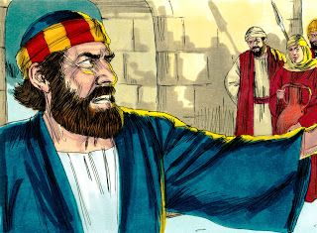
If Peter had chosen the people he was around more wisely, he might not have denied knowing Jesus.
Luke 22:33 – Peter told Jesus that he was willing to die for Him.
Luke 22:55-57 – A servant girl asked Peter if he knew Jesus and Peter said, “Woman, I do not know Him.”
Luke 22:58 – Someone else saw Peter and asked him the same question Peter said no once again.
Luke 22:59 – Another person asked again. Peter for the third time, said no.

Slide 7
Peter later redeemed himself.
Acts 2 – Peter preached the first gospel sermon
Matthew 16:17-19 – Jesus tells Peter that He will give Peter the keys of the kingdom of Heaven.

Slide 8
Picking Godly Friendships:
The motivation of Jesus
The mindset of Jesus
The moral life of Jesus
The mutual help from Jesus

Slide 9
Motivation of Jesus:
What caused Jesus to pick such godly friends? Why were His best friends His followers? The motivation that directed every decision that Jesus made was because He wanted to please and glorify God. (John 8:29) So, He did just that.

Slide 10
We need to please God and not people.
Galatians 1:10
“For do I now persuade men, or God? Or do I seek to please men? For if I still pleased men, I would not be a bondservant of Christ.”
Acts 5:29
“But Peter and the other apostles answered and said: ‘We ought to obey God rather than men.’”

Slide 11
Mindset of Jesus:
In 1 Peter 4, the ‘’mindset’’ is ‘’same mind’’. We don’t have to agree on EVERY LITTLE THING. But, we should have the same mindset as Jesus.
Paul encouraged the Corinthians to be of the “same mind” toward one another.
I Corinthians 1:10
“be perfectly joined together in the same mind and in the same judgment.”

Slide 12
Mindset of Jesus:
Jesus’s mind was based on love, strength, and discipline to remain strong in the faith.

Slide 13
Moral Life of Jesus:
We should seek the moral life of Jesus. Jesus is PERFECT and since there are none who are righteous (Romans 3:10) we need help in order to get to Heaven. That help comes in the form of grace and mercy.

Slide 14
I Corinthians 15:33
“Do not be deceived: ‘Evil company corrupts good habits.’”
If I don’t want to do bad, then I need to stay away from bad things.
If I want to be good, then I need to stay close to good things.

Slide 15
If you want to remain faithful to the Lord, then you should be sure that your closest friends share your goals of living a pure, moral life before God.

Slide 16
Mutual Help of Jesus:
We can ask for the help of Jesus by praying.
We also must surround ourselves with Christian friends who will help us along our life. (1 Peter 4:10)

Slide 17
Peter didn’t talk to the right people. Therefore, he denied Jesus 3 TIMES!!!
If we pick the right friends and people we will stay Christians and always be with God.
But, if we surround ourselves with bad people who don’t believe and who disobey Him, we turn out that way, too.

Slide 18
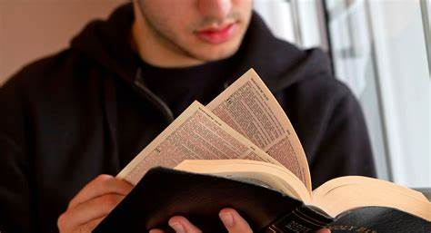
Picking Godly friendships won’t change the way you believe for SURE. But, it will help determine your walk with God.

Slide 19
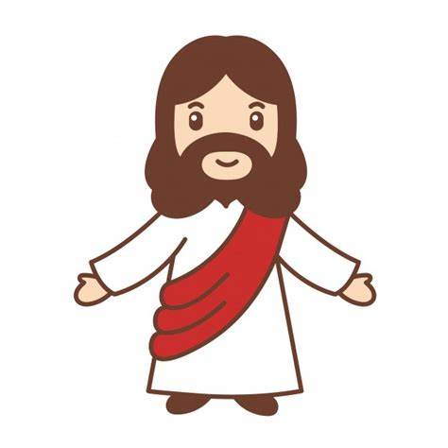
Who do YOU choose?
Jesus? or Earth?

Slide 20
CHOOSE WISELY!

